Slide 1
PREP R Session 3 April 14, 2019
Before the session, down load the two file:
Exercise file
Penn Box -> workshop -> session3_regression_visualization -> Linear_Reg_and_R_Visualization_Exercise.Rmd
Data file
Penn Box -> workshop -> session3_regression_visualization -> Galton_Heights -> Galton_Height.txt

Slide 2
Multiple Testing Adjustment
E.g. Suppose none of the genes are differentially expressed (DE) between case and controls
When testing for DE between genes using t-test, the distribution of p-values will be like the following figure

Slide 3
Multiple Testing Adjustment
E.g. Suppose none of the genes are differentially expressed (DE) between case and controls
When testing for DE between genes using t-test, the distribution of p-values will be like the following figure
There will always be some p-values < 0.05 (false positives; type I error) when the number of statistical tests is large

Slide 4
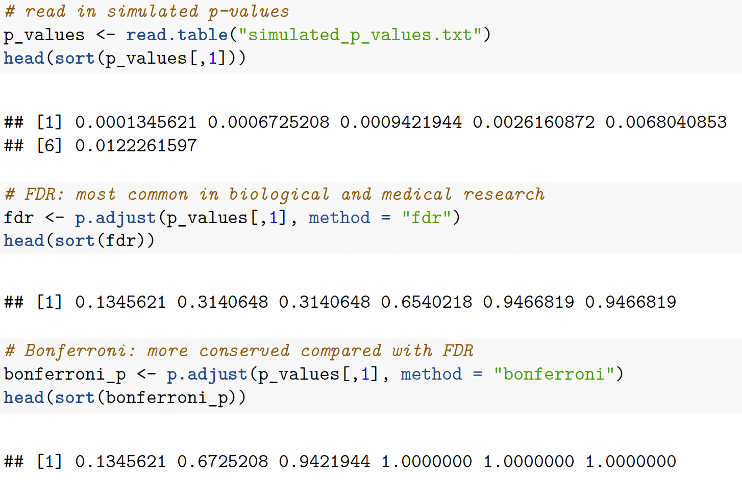
Multiple Testing Adjustment
Adjustment for multiple testing help reduce the proportion of false positives.

Slide 5
Exercise

Slide 6
Simple Linear Regression
Binglan Li
Modified based on slides from Dr. Yibi Huang
Department of Statistics
University of Chicago

Slide 7
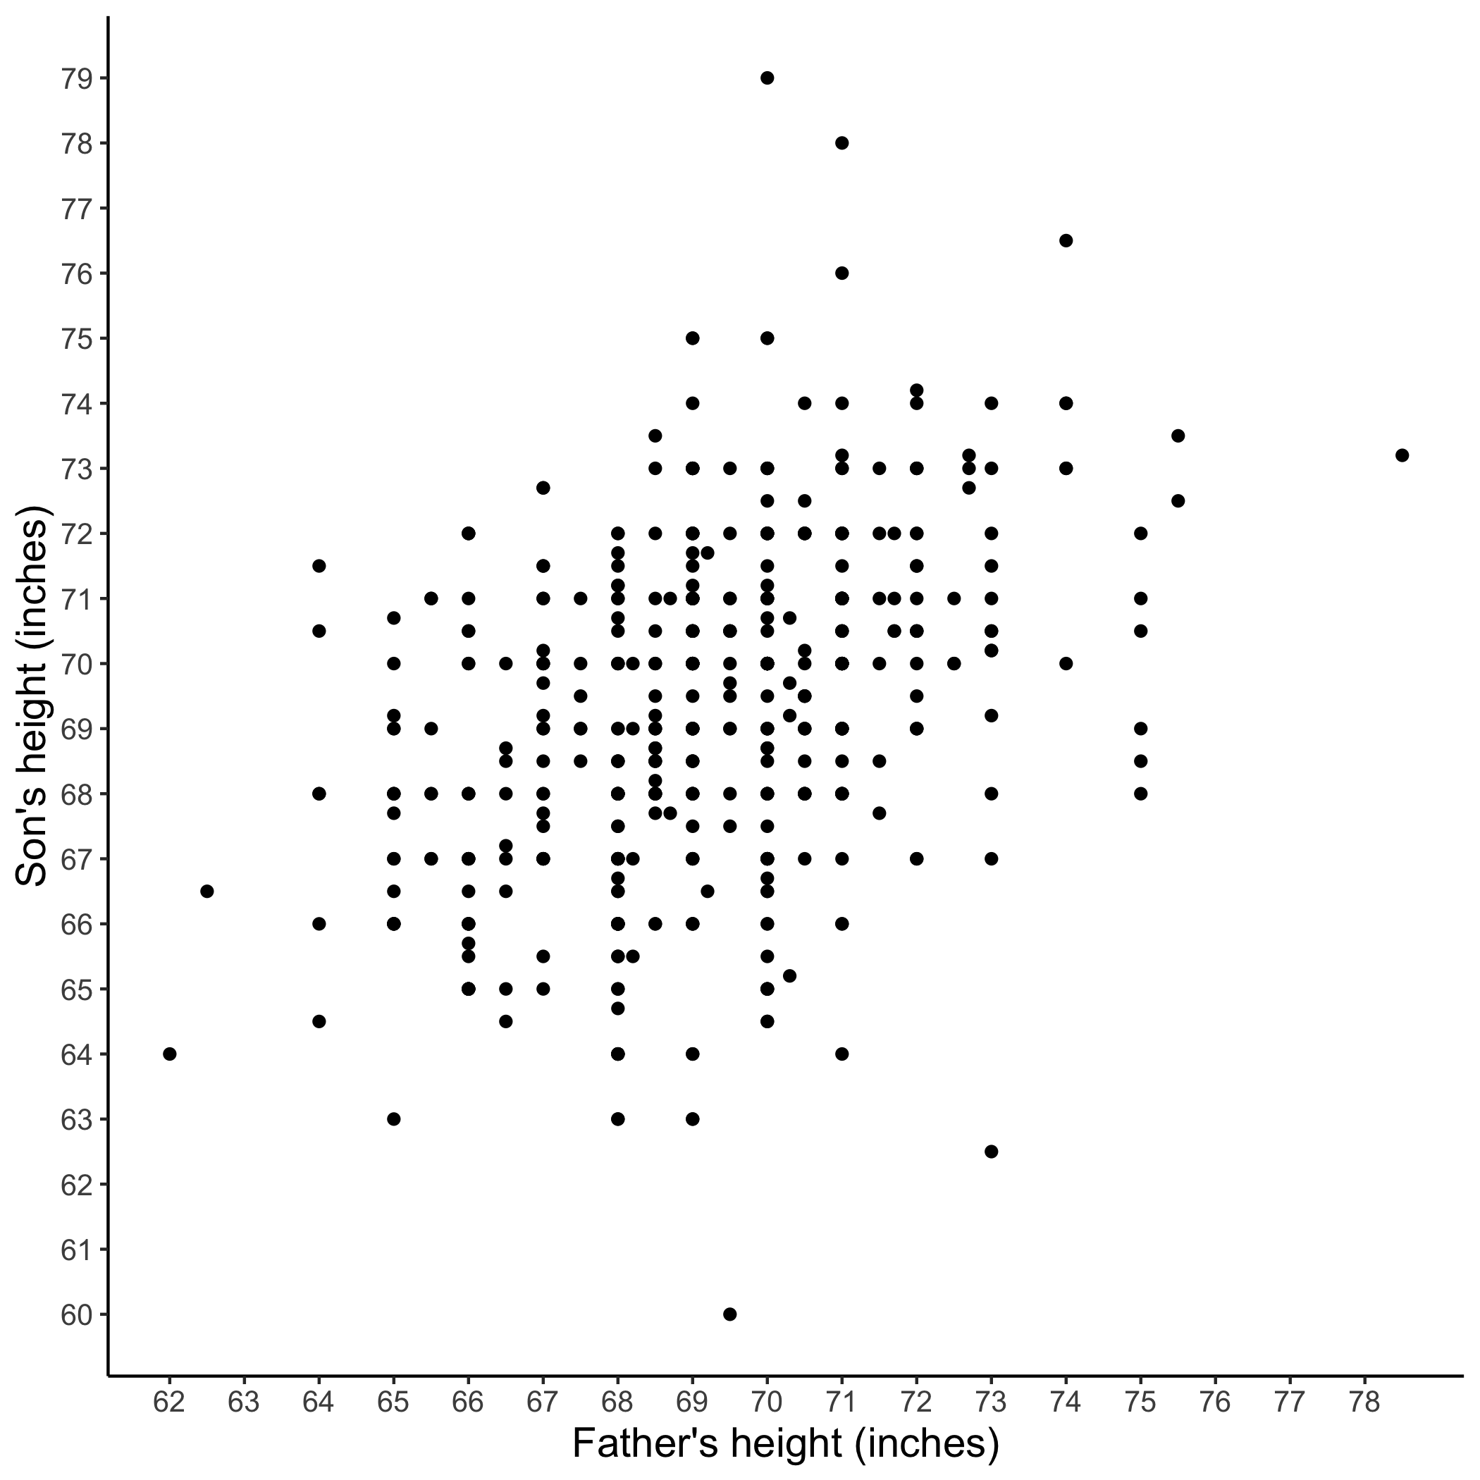
Example : Galton’s Father-and-Son Data
Heights of parents and their children collected by sir Francis Galton (1822-1911) in the late 19th century in England
Focusing on father-and-son pairs

Slide 8
Example : Galton’s Father-and-Son Data
Heights of parents and their children collected by sir Francis Galton (1822-1911) in the late 19th century in England
Focusing on father-and-son pairs
What’s the relationship between father’s height and son’s height?

Slide 9
Exercise 1.0

Slide 10
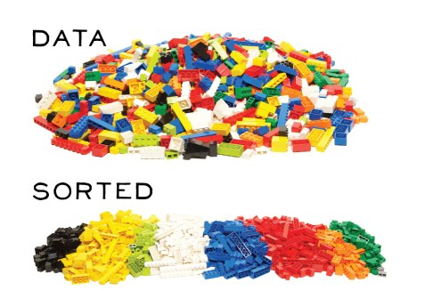
Data Cleaning
Get to know your data

Slide 11
Exercise 1.1
Can you guess how much time is devoted to data cleaning in a bioinformatic project?
80% in general!

Slide 12
Correlation vs Linear Regression
Both are statistical approaches to measure relationships between variables

Slide 13
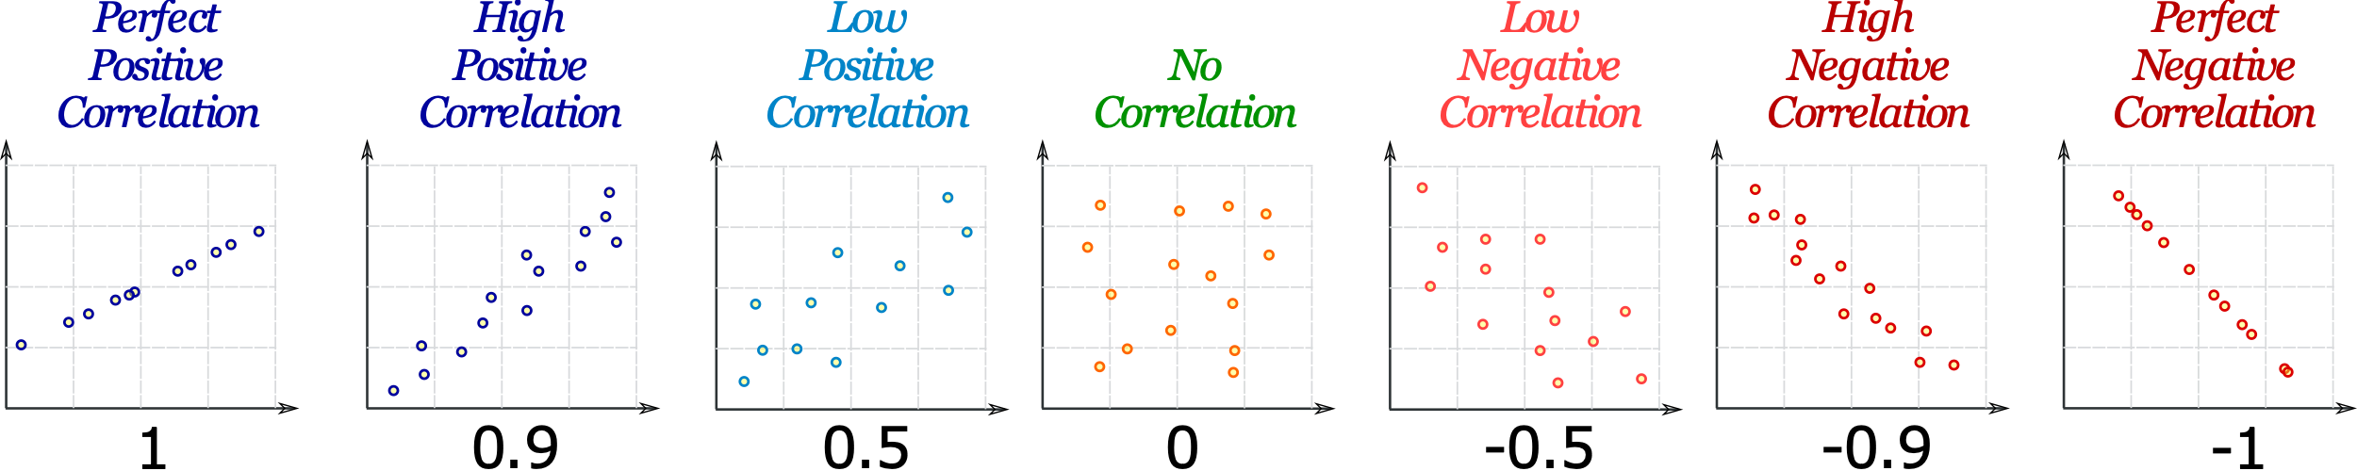
Correlation
Definition: the extent to which the two variables fluctuate with each other
The most common approach is Pearson’s Correlation Coefficient which ranges from -1 to 1.
Notes:
Definition: The dependence between two variables. Usually correlation indicates the extent to which the two variables fluctuate with each other.

Slide 14
Exercise 1.2
Can you guess what is the correlation between father’s and son’s heights? Use R to test your guess!

Slide 15
Correlation
Regression
Existence of linear relationship between father’s and son’s height
The direction of the relationship
The strength of the relationship

Slide 16
Correlation
Regression
Existence of linear relationship between father’s and son’s height
The direction of the relationship
The strength of the relationship
Existence of linear relationship between father’s and son’s height
The direction of relationships
The strength of the relationship

Slide 17
Correlation
Regression
Existence of linear relationship between father’s and son’s height
The direction of the relationship
The strength of the relationship
Existence of linear relationship between father’s and son’s height
The direction of relationships
The strength of the relationship
Estimate the effect of father’s height on son’s height
Predict future data on father-and-son height

Slide 18
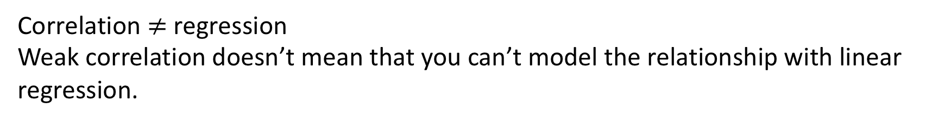
Correlation
Regression
Existence of linear relationship between father’s and son’s height
The direction of the relationship
The strength of the relationship
Existence of linear relationship between father’s and son’s height
The direction of relationships
The strength of the relationship
Estimate the effect of father’s height on son’s height
Predict future data on father-and-son height
Correlation $≠$ regression
Weak correlation doesn’t mean that you can’t model the relationship with linear regression.

Slide 19
Regression is a type analytic method to make statistical inference
Population: the set of all observations of interest, e.g. heights of all father-and-son pairs in the world
Population

Slide 20
Regression is a type analytic method to make statistical inference
Population: the set of all observations of interest, e.g. heights of all father-and-son pairs in the world
Sample: the subset of observations collected from the population of interest, e.g. heights of collected father-and-son pairs
Population
Sampling
Samples

Slide 21
Regression is a type analytic method to make statistical inference
Population: the set of all observations of interest, e.g. heights of all father-and-son pairs in the world
Sample: the subset of observations collected from the population of interest, e.g. heights of collected father-and-son pairs
Population
Inference
Sampling
Samples

Slide 22
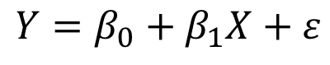
Definition of Simple Linear Regression (SLR)
$$Y=β_{0}+β_{1}X+ε$$
Notes:
An approach for modelling the relationship between a quantitative response Y and a single predictor variable X.

Slide 23
Definition of Simple Linear Regression (SLR)
$$Y=β_{0}+β_{1}X+ε$$
$$Son^{′}s Height=β_{0}+β_{1}×Father^{′}s Height+ε$$

Slide 24
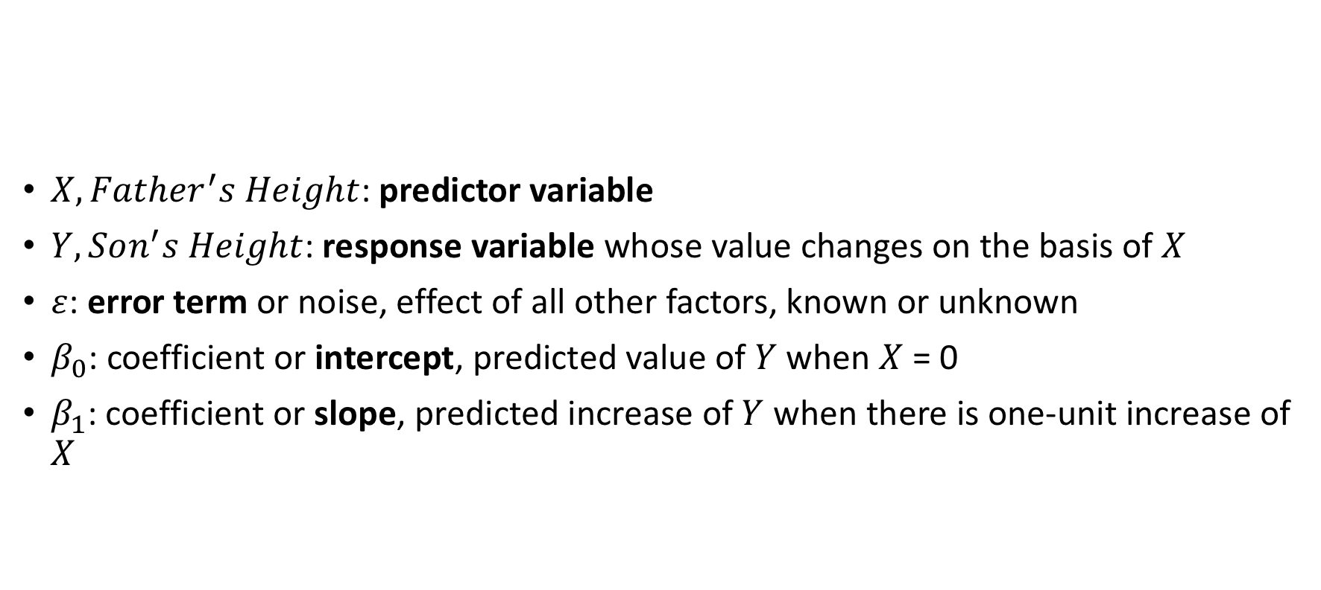
Definition of Simple Linear Regression (SLR)
$X,Father^{′}s Height$: predictor variable
$Y,Son^{′}s Height$: response variable whose value changes on the basis of $X$
$ε$: error term or noise, effect of all other factors, known or unknown
$β_{0}$: coefficient or intercept, predicted value of $Y$ when $X$ = 0
$β_{1}$: coefficient or slope, predicted increase of $Y$ when there is one-unit increase of $X$
$$Y=β_{0}+β_{1}X+ε$$
$$Son^{′}s Height=β_{0}+β_{1}×Father^{′}s Height+ε$$
Notes:
Explanation of equations

Slide 25
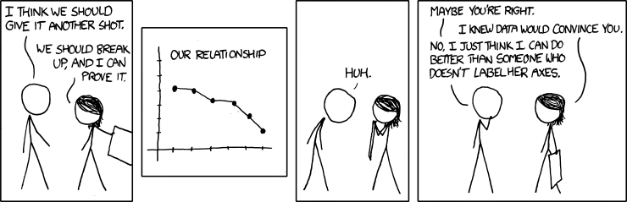
Definition of Simple Linear Regression (SLR)
$$Y=β_{0}+β_{1}X+ε$$
$$Son^{′}s Height=β_{0}+β_{1}×Father^{′}s Height+ε$$
Defining predictors and response is a nontrivial task

Slide 26
Definition of Simple Linear Regression (SLR)
$$Y=β_{0}+β_{1}X+ε$$
$$Son^{′}s Height=β_{0}+β_{1}×Father^{′}s Height+ε$$
Defining predictors and response is a nontrivial task
X: Time
Y: Relationship
X: Time
Y: Sadness
Notes:
Knowing what relationship you are assuming and modelling is important in regression.

Slide 27
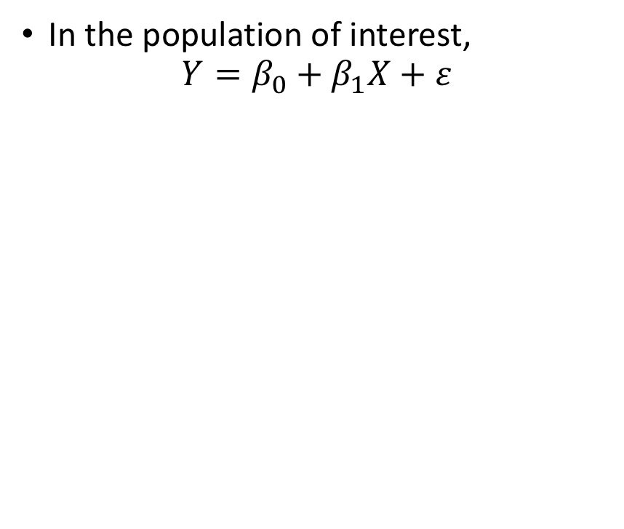
Denotes the Estimated/Predicted Values
In the population of interest,
$$Y=β_{0}+β_{1}X+ε$$
Population
Inference
Sampling
Samples
Notes:
Add hat
Change to father and son’s height data

Slide 28
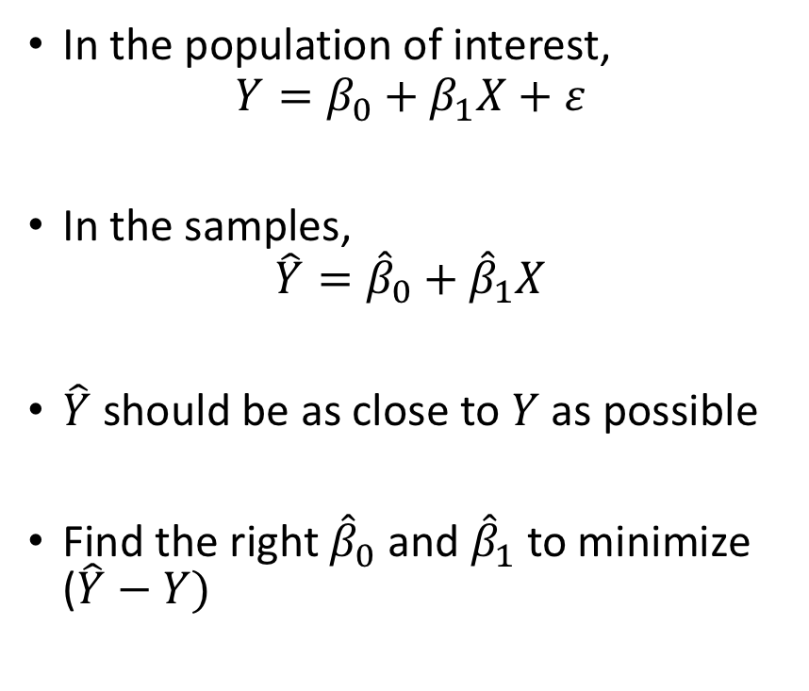
Denotes the Estimated/Predicted Values
In the population of interest,
$$Y=β_{0}+β_{1}X+ε$$
In the samples,
$$\hat{Y}={\hat{β}}_{0}+{\hat{β}}_{1}X$$
$\hat{Y}$ should be as close to $Y$ as possible
Find the right ${\hat{β}}_{0}$ and ${\hat{β}}_{1}$ to minimize ($\hat{Y}−Y)$
Population
Inference
Sampling
Samples
Notes:
Add hat
Change to father and son’s height data

Slide 29
Finding the Best Intercept and Slope
Goal of a SLR
Minimize the differences between observations and predicted values (residual)
The most common approach to find the minimal overall residuals is the least squares criterion, which is adopted in a linear regression function, lm()
Notes:
Introduction of Residuals
Introduction to lm, which uses least square

Slide 30
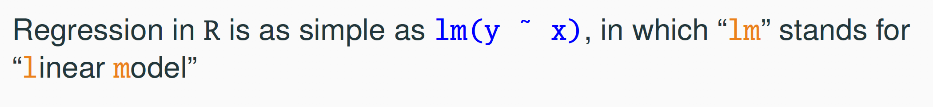
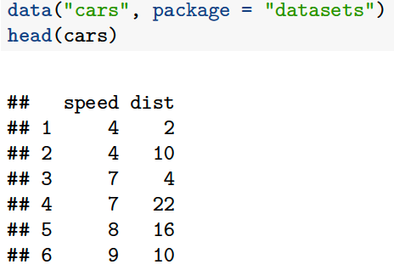
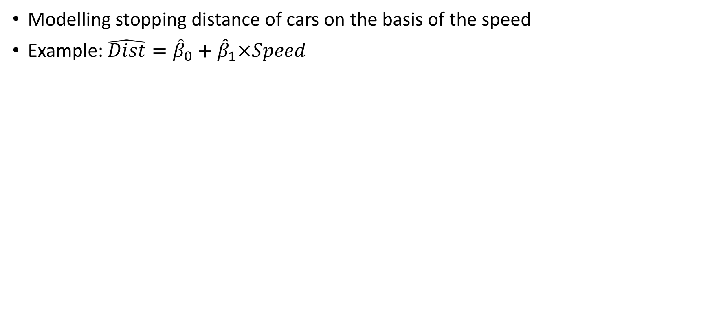
SLR in R - lm()
Modelling stopping distance of cars on the basis of the speed
Example: $\hat{Dist}={\hat{β}}_{0}+{\hat{β}}_{1}×Speed$

Slide 31
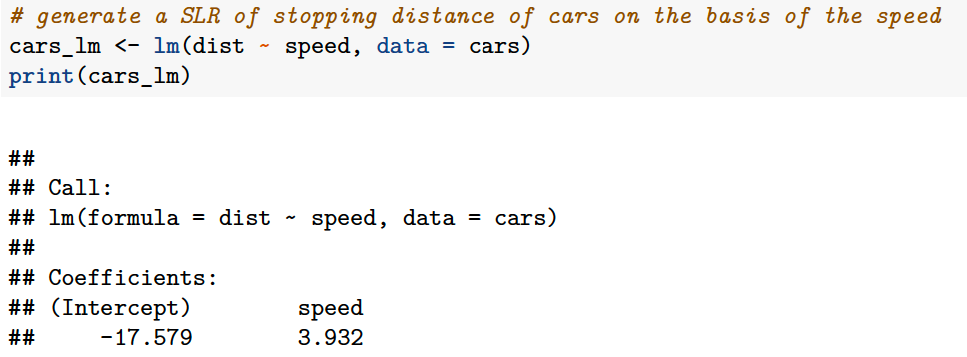
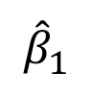
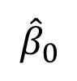
SLR in R - lm()
Modelling stopping distance of cars on the basis of the speed
Example: $\hat{Dist}={\hat{β}}_{0}+{\hat{β}}_{1}×Speed$
$${\hat{β}}_{0}$$
$${\hat{β}}_{1}$$

Slide 32
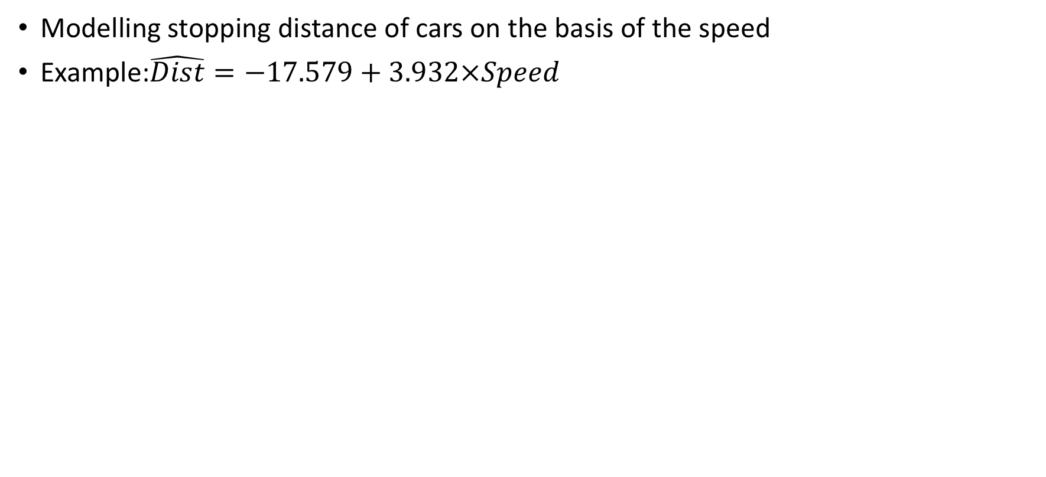
SLR in R - lm()
Modelling stopping distance of cars on the basis of the speed
Example:$\hat{Dist}=−17.579+3.932×Speed$
$${\hat{β}}_{0}$$
$${\hat{β}}_{1}$$

Slide 33
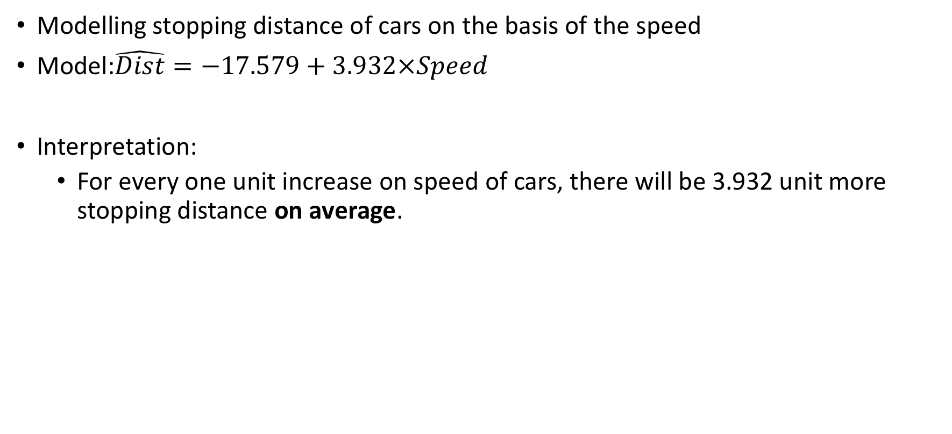
Interpretation of the Output
Modelling stopping distance of cars on the basis of the speed
Model:$\hat{Dist}=−17.579+3.932×Speed$
Interpretation:
For every one unit increase on speed of cars, there will be 3.932 unit more stopping distance on average.

Slide 34
Exercise 1.3
SLR in R - lm()

Slide 35
Assumptions of SLR
Linearity
Constant variance of errors
Independence of errors
Assumptions are the premise of linear regressions to make statistical inference of the population of interest.
If assumptions are not satisfied, the fitted regression models are likely not accurate in predicting future data.
Notes:
What it means and consequences of violating assumptions
Independence of errors are most likely to be violated in time-series data
Detailed examples are introduced later

Slide 36
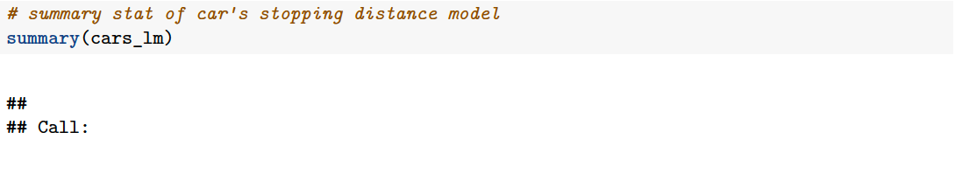
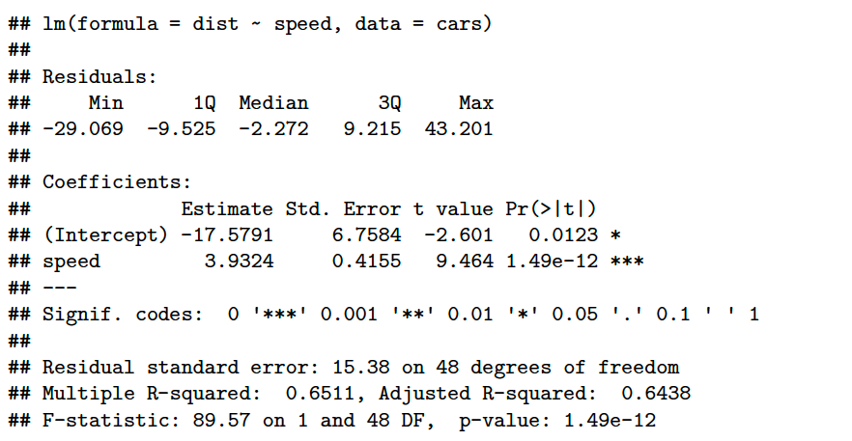
Additional Output from Summary()
Provides essential statistics about the accuracy of the model

Slide 37
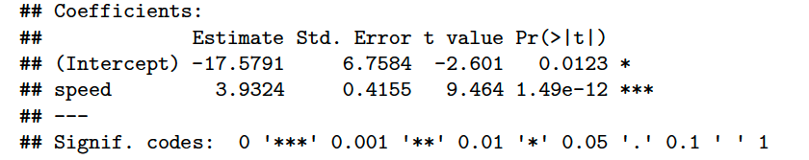
Significant of Slope
Significance of slope
Is there a relationship between X and Y?
I.e. Does the slope equal to 0?

Slide 38
Additional Output from Summary()
Provides essential statistics about the accuracy of the model

Slide 39

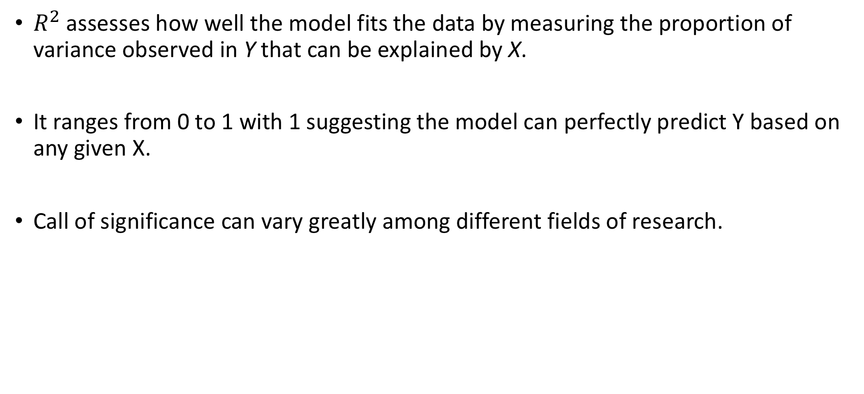
Interpretations of Summary() – $R^{2}$
$R^{2}$ assesses how well the model fits the data by measuring the proportion of variance observed in Y that can be explained by X.
It ranges from 0 to 1 with 1 suggesting the model can perfectly predict Y based on any given X.
Call of significance can vary greatly among different fields of research.
Multiple R-squared: 0.6511
Notes:
R-square equals to the square of Pearson Correlation Coefficient between X and Y. Surprise!

Slide 40
Exercise 1.4

Slide 41
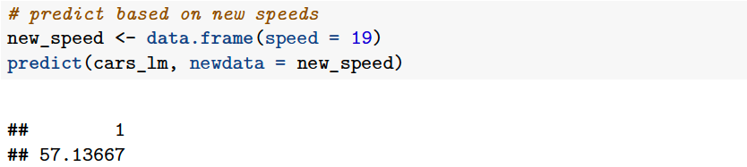
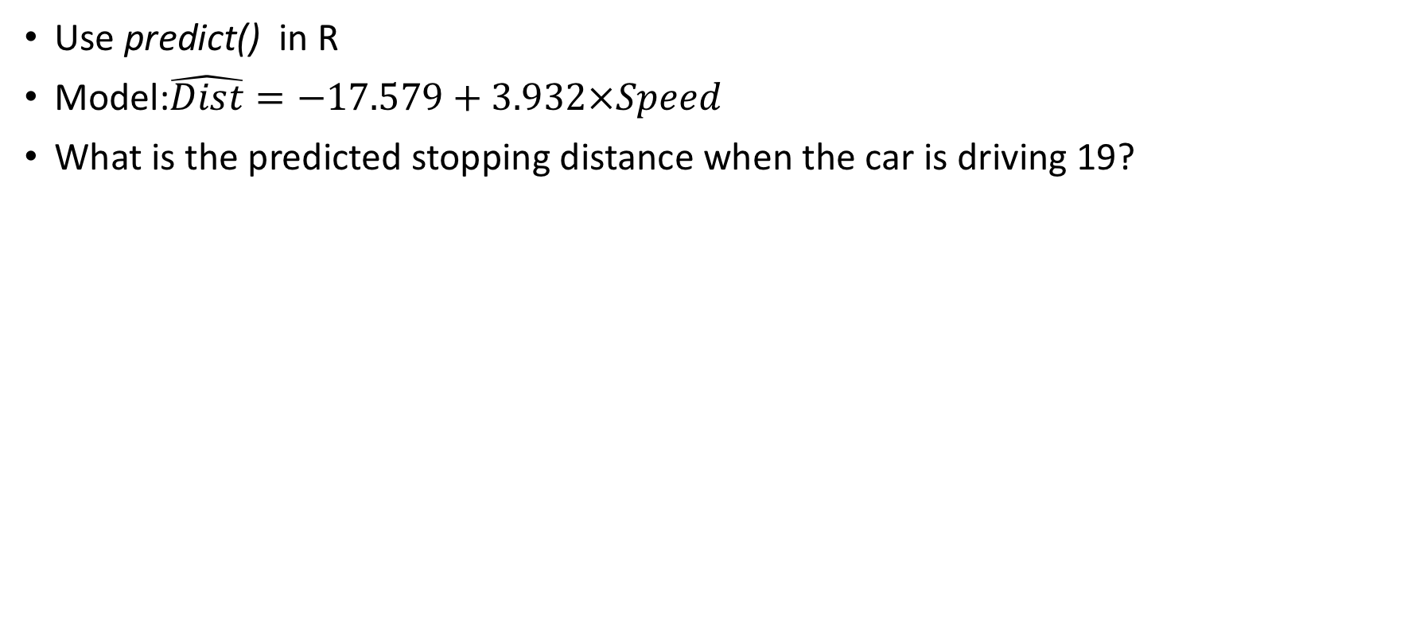
Predict based on your regression model
Use predict() in R
Model:$\hat{Dist}=−17.579+3.932×Speed$
What is the predicted stopping distance when the car is driving 19?

Slide 42
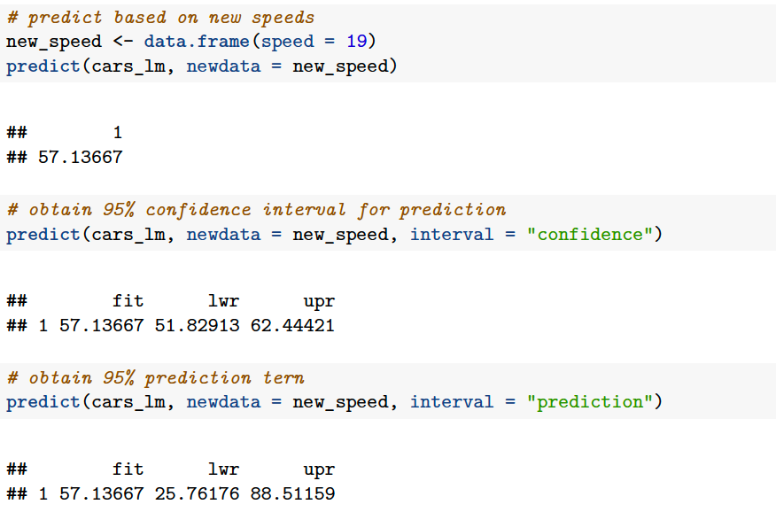
Confidence Interval & Prediction Interval of Prediction
Confidence interval
According to our model, a car with a speed of 19 mph has, on average, a stopping distance ranging between 51.83 and 62.44 ft.

Slide 43
Confidence Interval & Prediction Interval of Prediction
Confidence interval
According to our model, a car with a speed of 19 mph has, on average, a stopping distance ranging between 51.83 and 62.44 ft.
Prediction Interval
According to our model, 95% of the cars with a speed of 19 mph have a stopping distance between 25.76 and 88.51.

Slide 44
Exercise 1.5
Prediction based on your SLR model using predict()

Slide 45



Slide 46
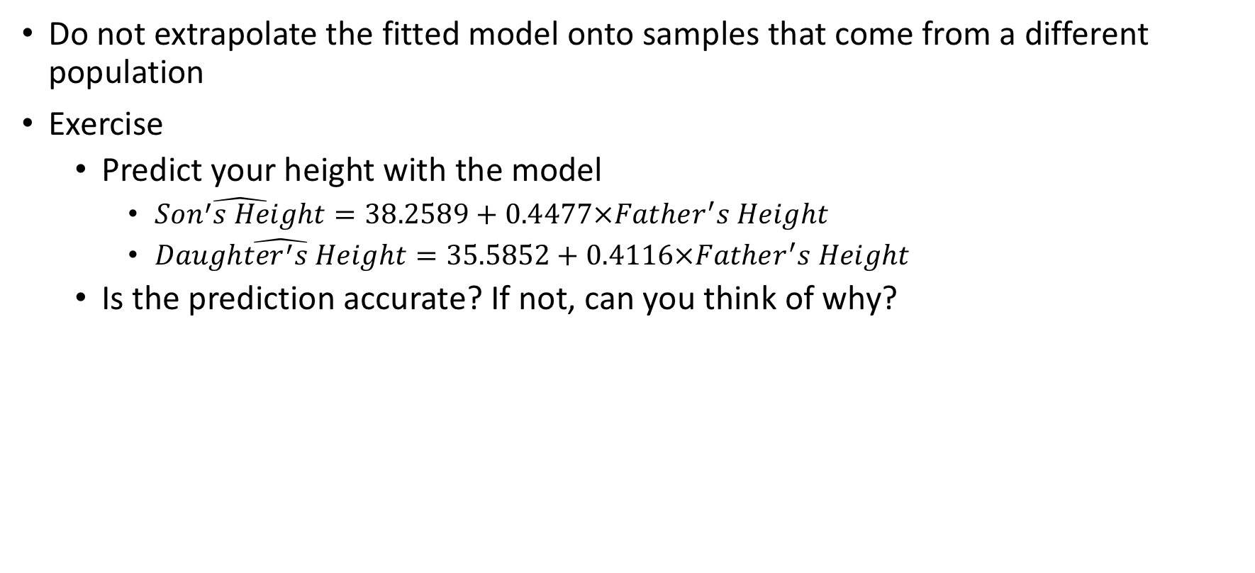
Prediction - Cautions
Do not extrapolate the fitted model onto samples that come from a different population
Exercise
Predict your height with the model
$\hat{Son^{′}s Height}=38.2589+0.4477×Father^{′}s Height$
$\hat{Daugh{ter}^{′}s Height}=35.5852+0.4116×Father^{′}s Height$
Is the prediction accurate? If not, can you think of why?
Notes:
Does the socioeconomic background of the data match yours? Remember, this is a dataset collect at 19th century from families residing in London.

Slide 47
Assumptions of SLR
Linearity
the relationship between X and Y is linear
the slope of the regression equation does not change as X changes
Constant variance
Change fitted SLR models if violated
Independence of errors
The value of one error provides little or no information about the next error
When it happens, one might erroneously claim that the regression model is significant while it is actually not.
Notes:
What it means and consequences of violating assumptions
Independence of errors are most likely to be violated in time-series data

Slide 48
Importance of Assumptions
Assumptions are the premise of linear regressions to make statistical inference of the population of interest.
If assumptions are not satisfied, the fitted regression models are likely not accurate in predicting future data.
Always make sure that data satisfy the assumptions of the statistical methods you use!
Remediation for assumptions will be introduced later.

Slide 49
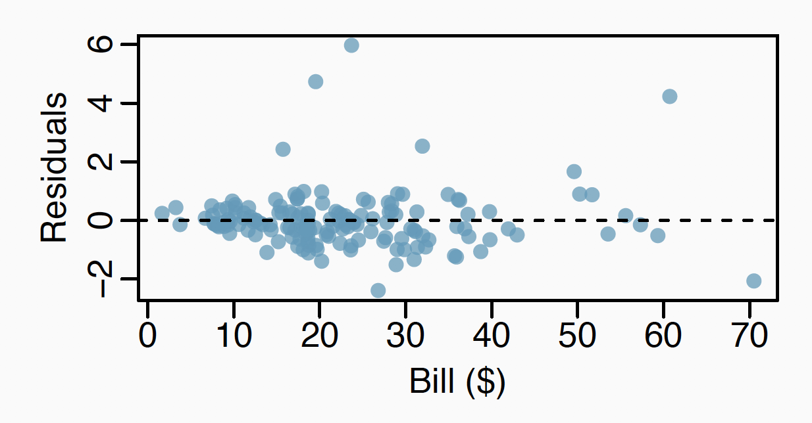
Tool for checking violation of SLR Assumptions
Tool
Residual plot with X as x-axis and residuals as Y-axis
If all assumptions are satisfied, points of residuals should scatter evenly around the zero line in the residual plot

Slide 50
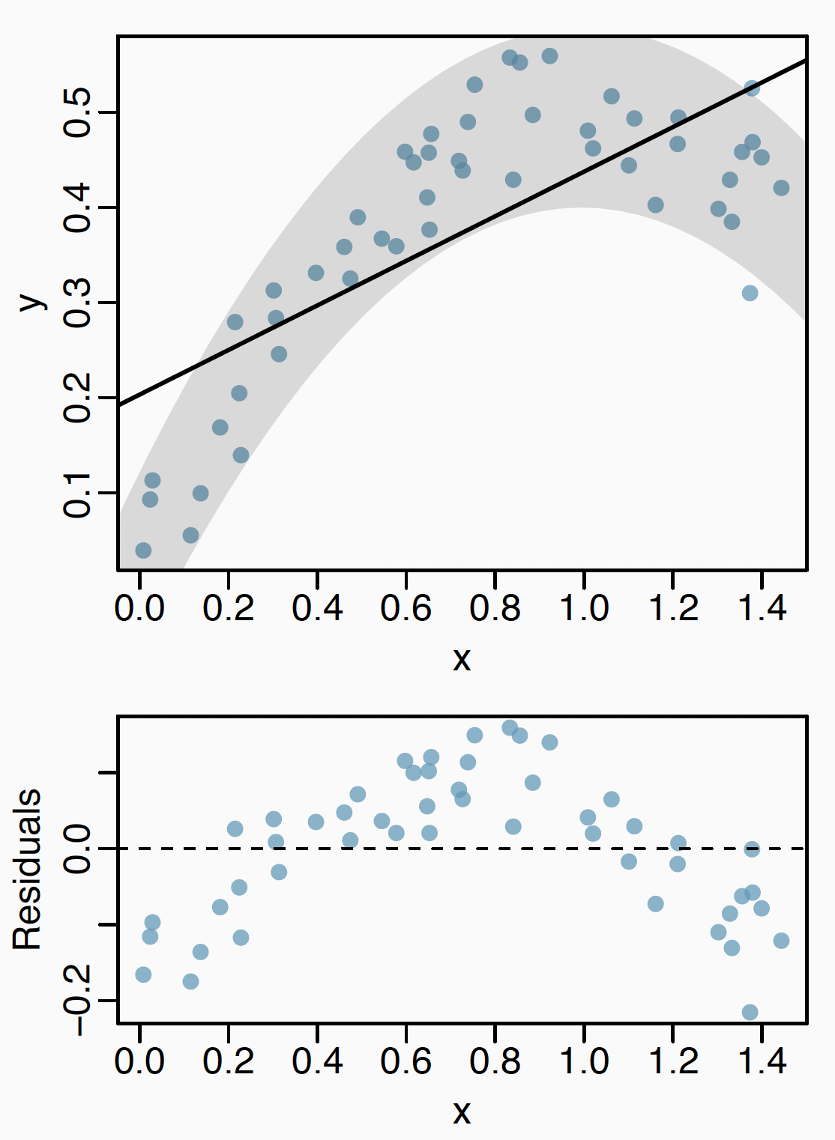
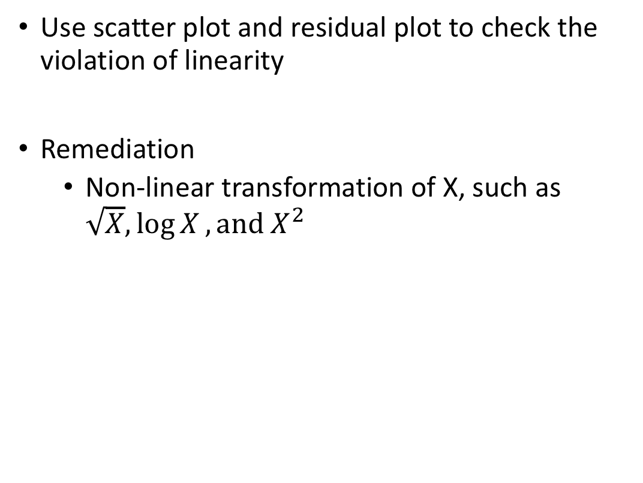
Violation of Linearity
Use scatter plot and residual plot to check the violation of linearity
Remediation
Non-linear transformation of X, such as $\sqrt{X},\log{X}, {\text{and} X}^{2}$

Slide 51
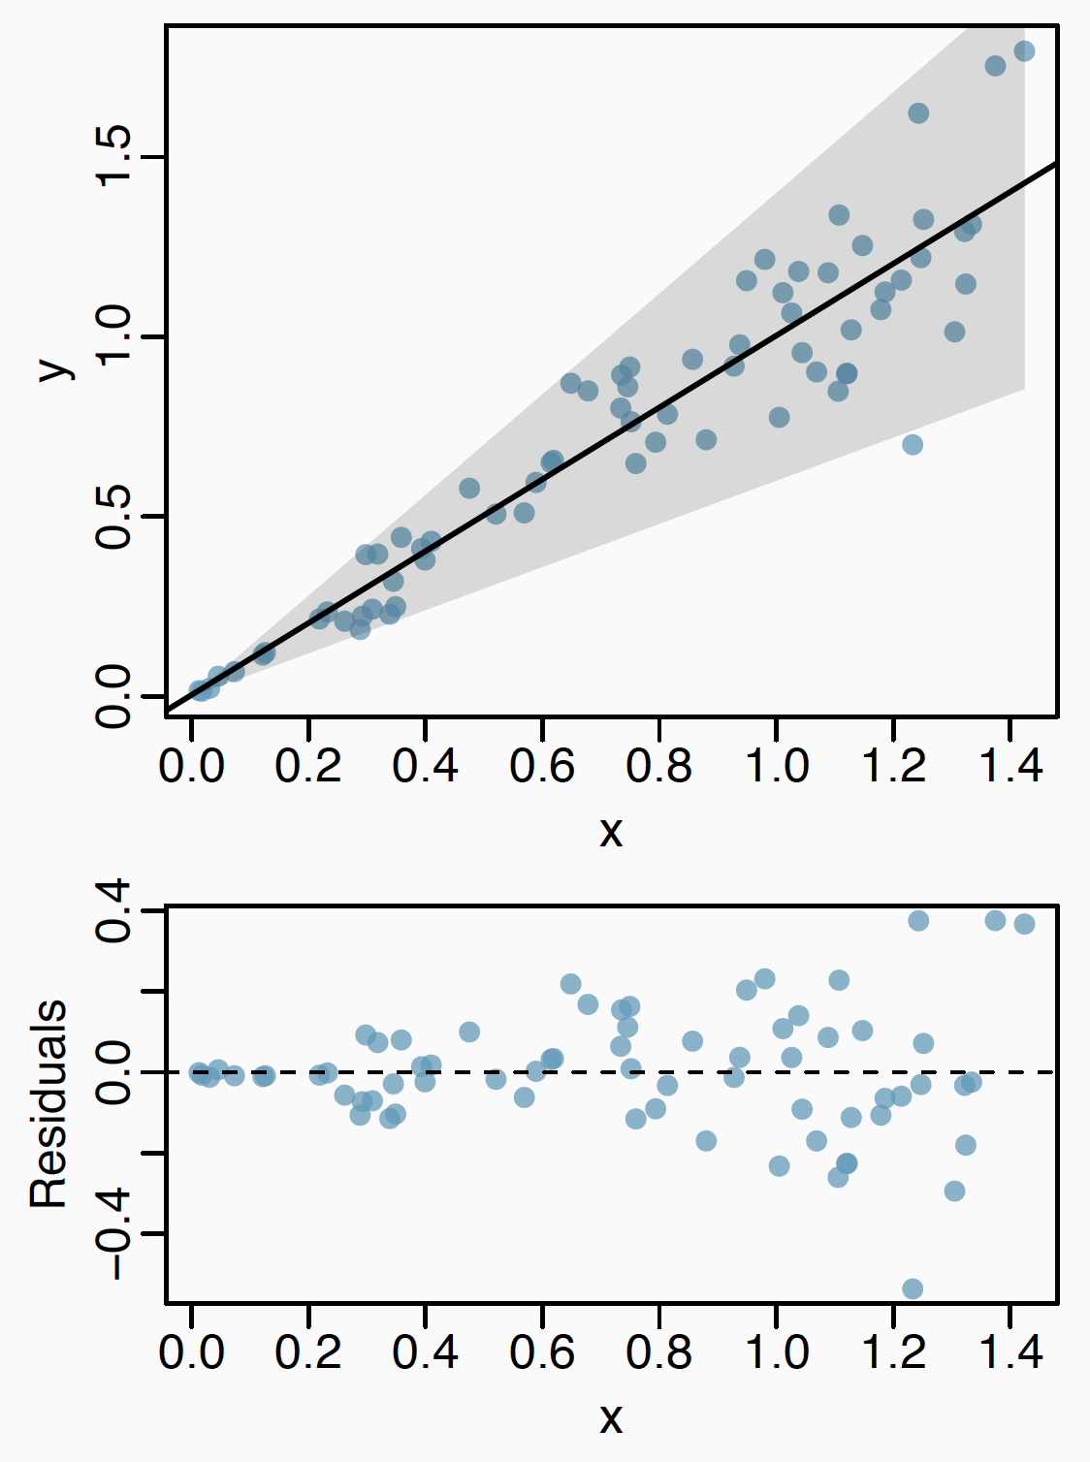
Violation of constant errors
Remediation
Transformation of response
Other regression methods, like weighted least-square method

Slide 52
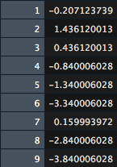
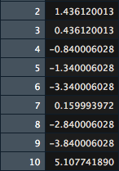
Violation of Independence of Errors
Fit a SLR on the lagged residuals and a significant slope will suggest violation of the assumption of independent errors.
Remediation
Depends on data
Find out the reason, clean data, and redo analysis
Residuals with lag = 1

Slide 53
(Optional) Exercise 1.6

Slide 54
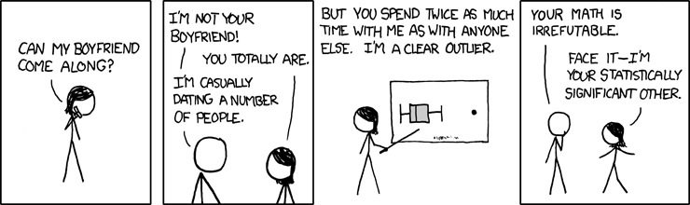
Outliers

Slide 55
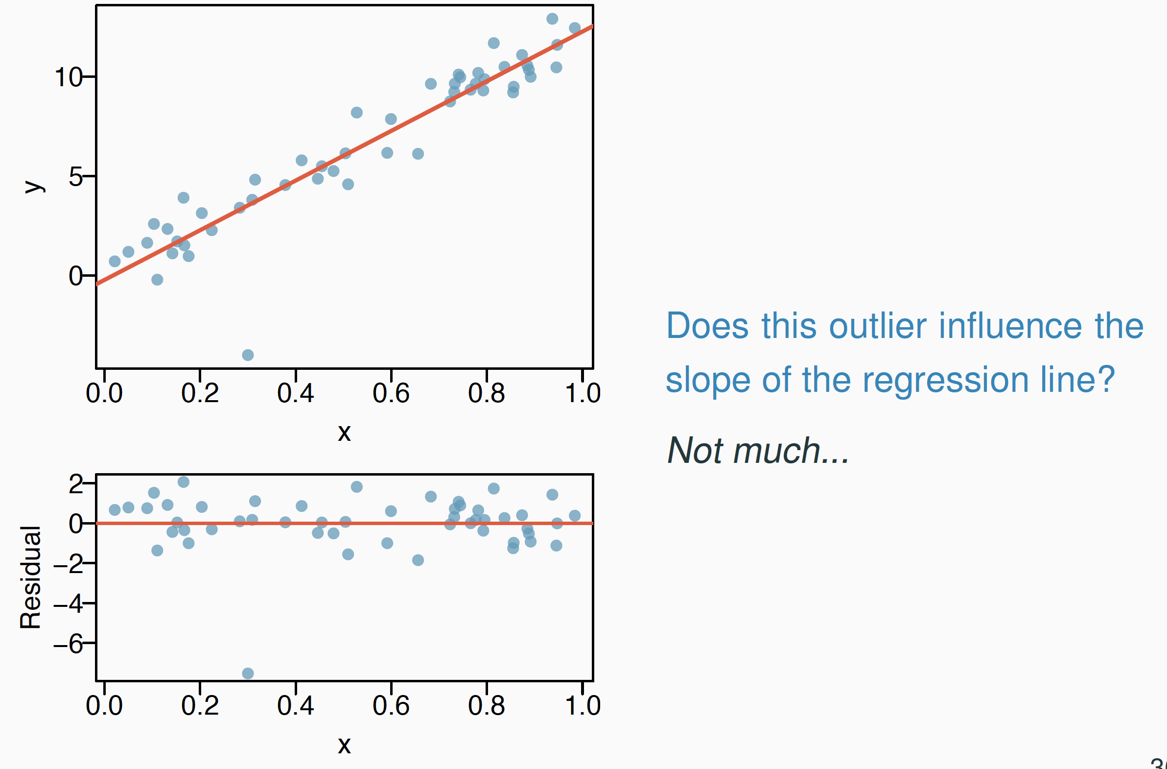
Types of Outliers - Outlier
Outliers
Data points that have large residual

Slide 56
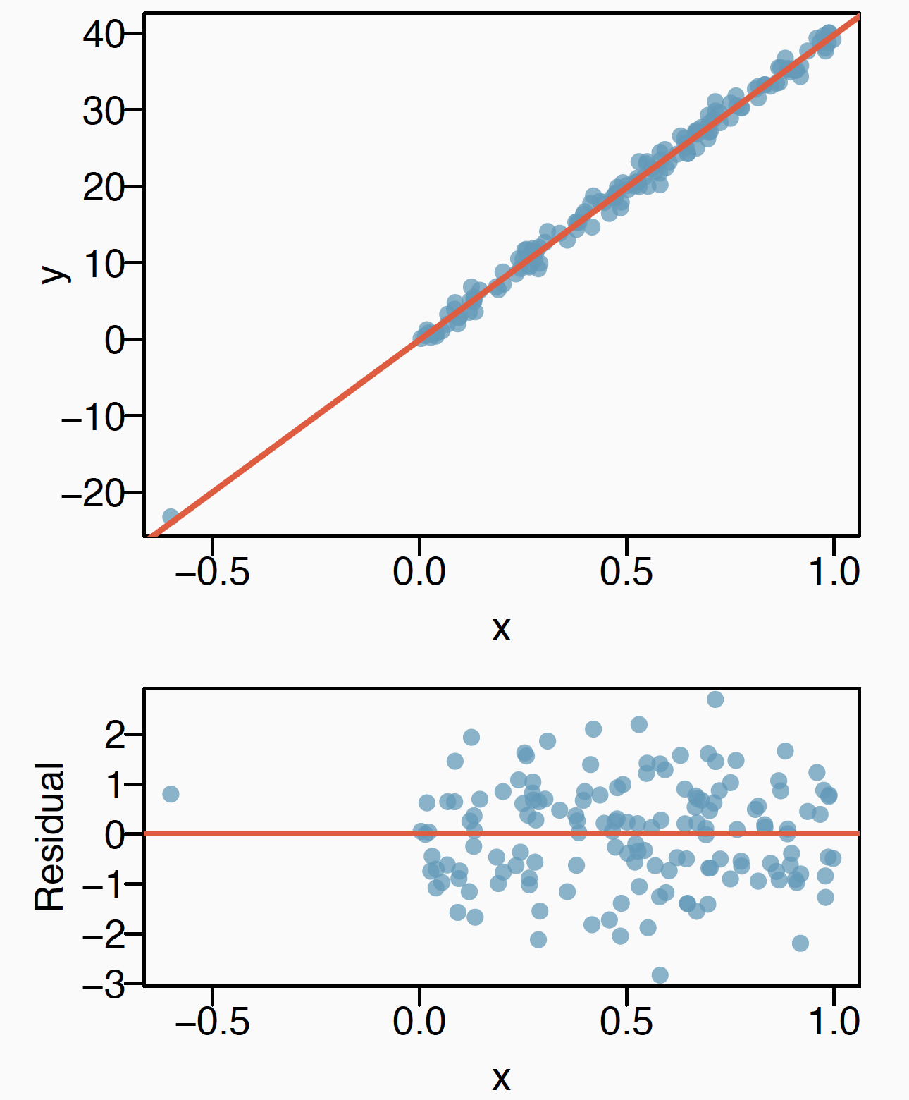
Types of Outliers – High Leverage Points
High Leverage Points
Data points that sit away from the center of the rest data points along x axis

Slide 57
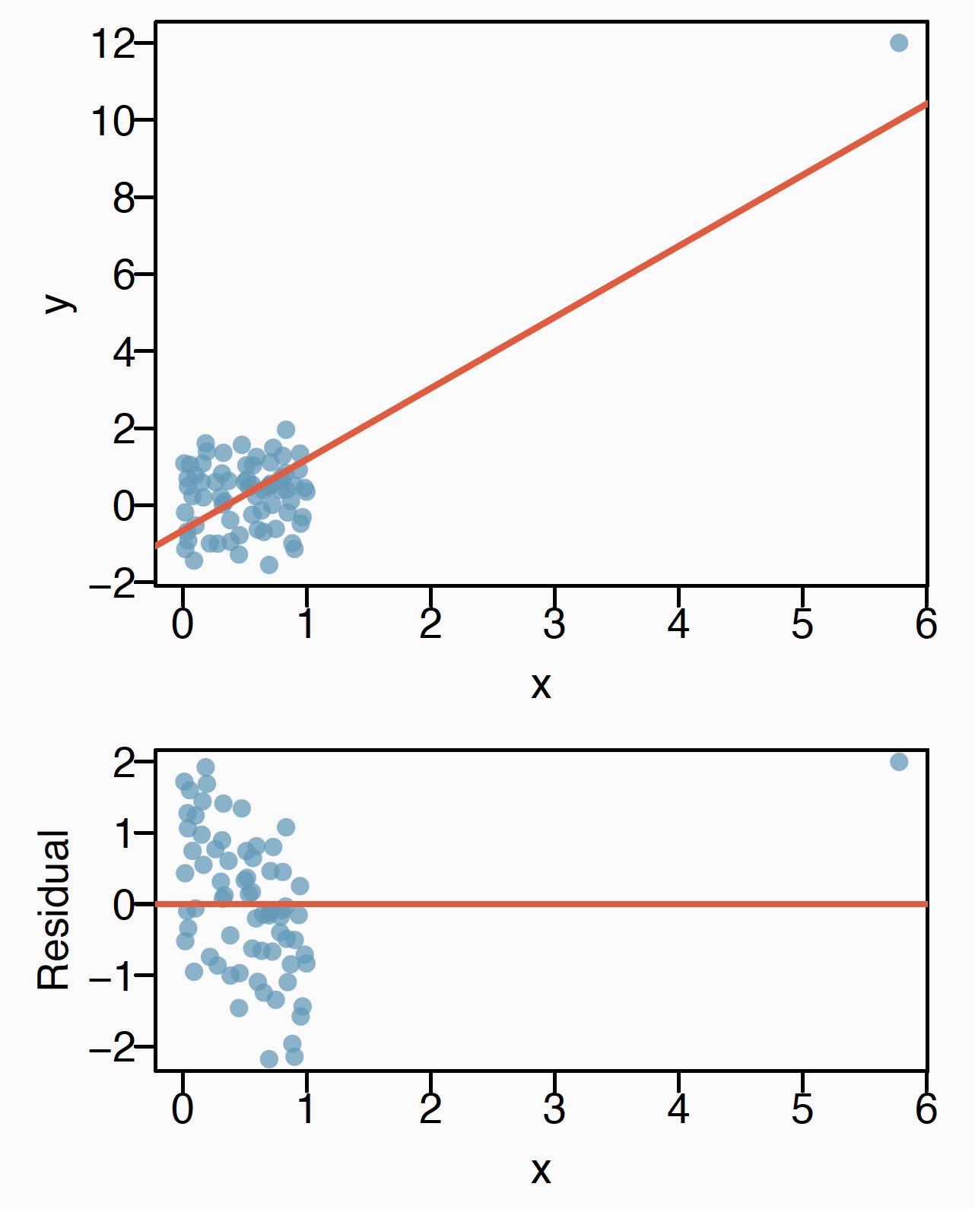
Types of Outliers – Influential Points
Influential points must be outliers with high leverage
Influential points will change the slope of the regression models
E.g. Without the influential point, there is no evident relationship between X and Y in the right figure
Find influential points through scatter plot or residual plot
Identify and remove influential points using your own judgement

Slide 58
(Optional) Exercise 1.7

Slide 59
R Visualization
Notes:
https://privefl.github.io/R-presentation/ggplot2.html
https://r4ds.had.co.nz/data-visualisation.html
https://ytliu0.github.io/Stat390EF-R-Independent-Study-archive/RMarkdownExercises/Galton_solution.html

Slide 60
Introduction to ggplot2 Package
ggplot2 is a system for declaratively creating graphics, based on The Grammar of Graphics.
The grammar of graphics is a grammar used to describe the basic elements in graphs.

Slide 61
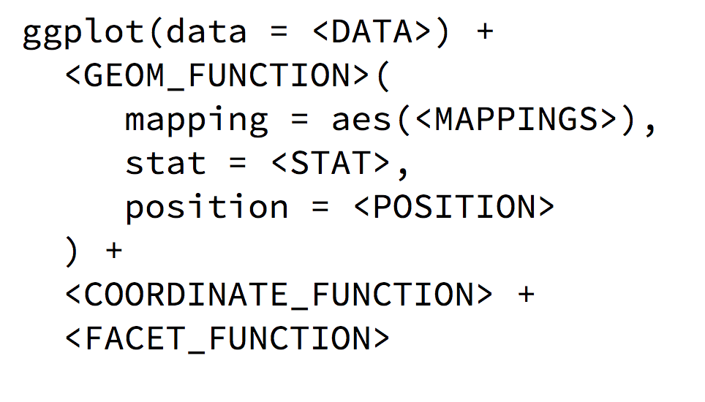
Think of the Way You Draw a Plot
1. What data to draw a figure about?
2. What are X and Y axis?
3. Each single data points or counts?
4. Transformation of axis
5. …

Slide 62
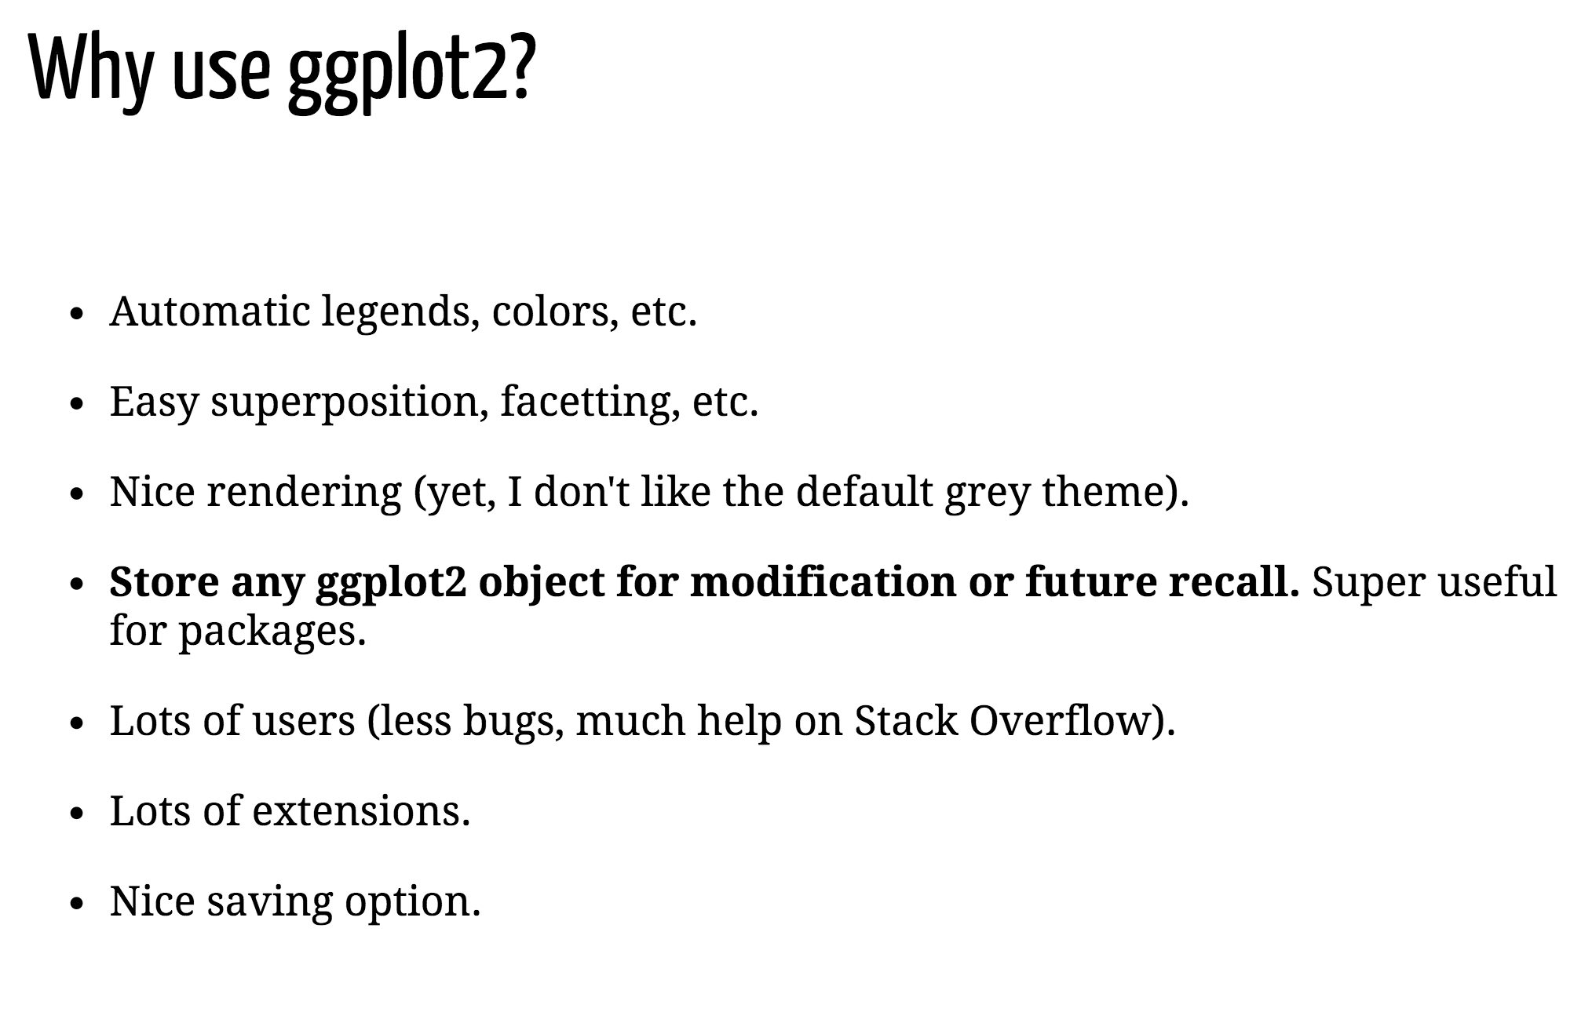

Slide 63
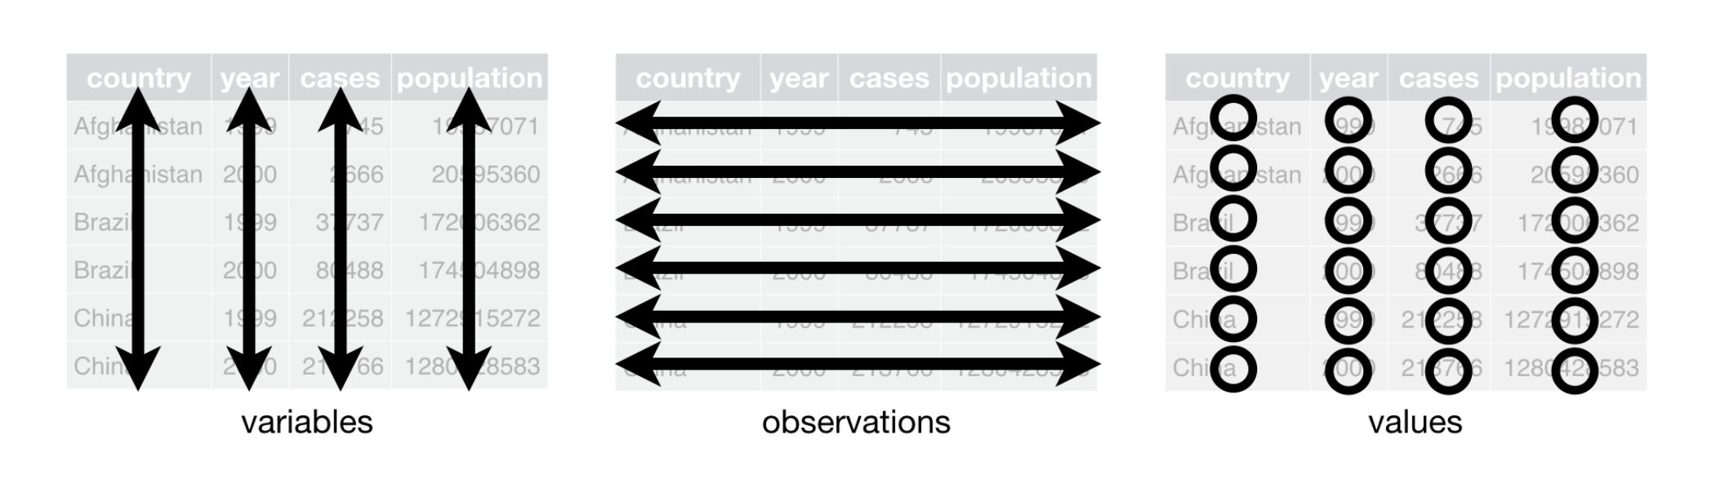
ggplot2 Expects Tidy Data

Slide 64
Exercise 2.0
Load ggplot2 and data in R
Notes:
Give example of codes
Load Load

Slide 65
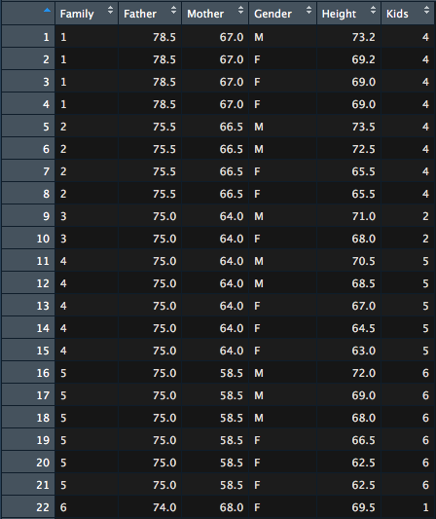
Check the Content of the Dataset

Slide 66
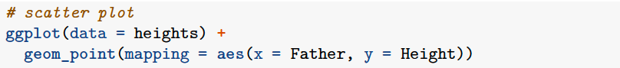
Take the First Step – Draw a Scatter Plot with ggplot2
Notes:
Break down codes into how to load datasets and how to map variables

Slide 67
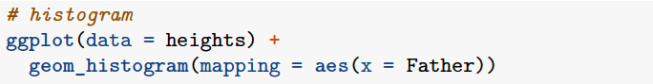
Take the Second Step – What about Histogram?

Slide 68
Exercise 2.1
Try plotting using ggplot2 by yourself

Slide 69
Add Colors

Slide 70
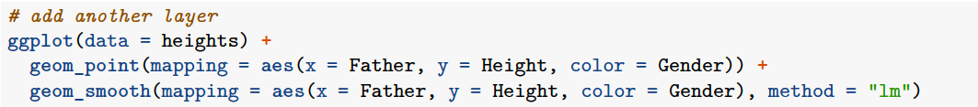
Add Another Layer

Slide 71
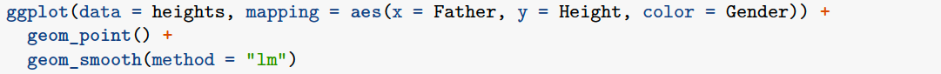
Move ‘aes’ to the Top

Slide 72
Move ‘aes’ to the Top or Not
Notes:
Add geom_abline

Slide 73
Exercise 2.2

Slide 74
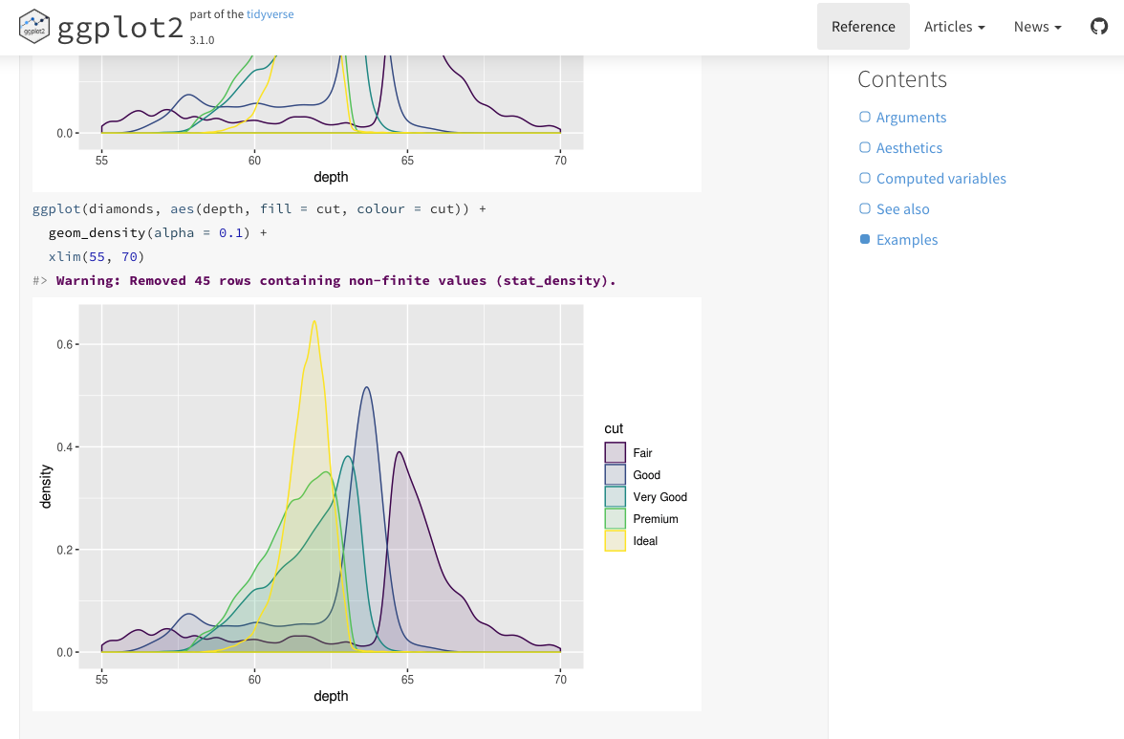
Density Plot of Two Distributions
ggplot2 Reference provides useful examples

Slide 75
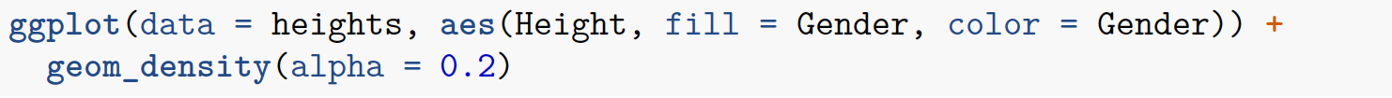
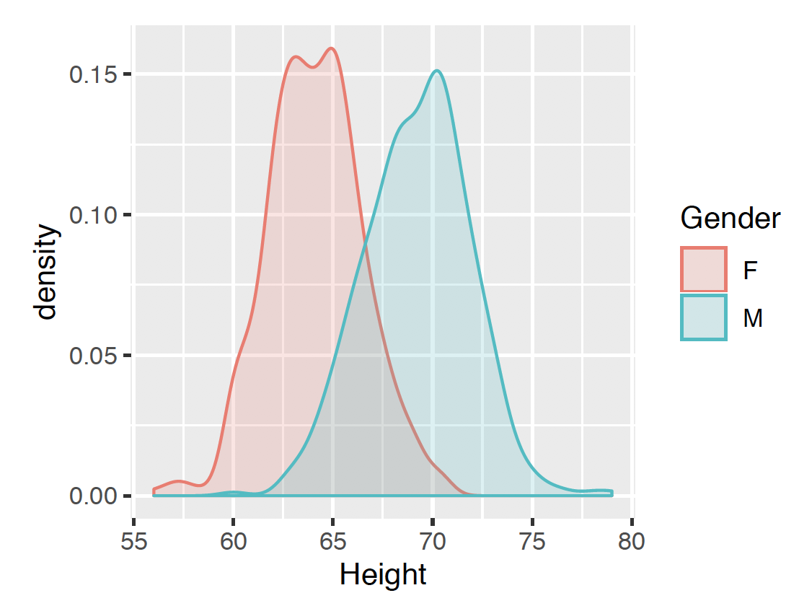
Density Plot of Two Distributions

Slide 76
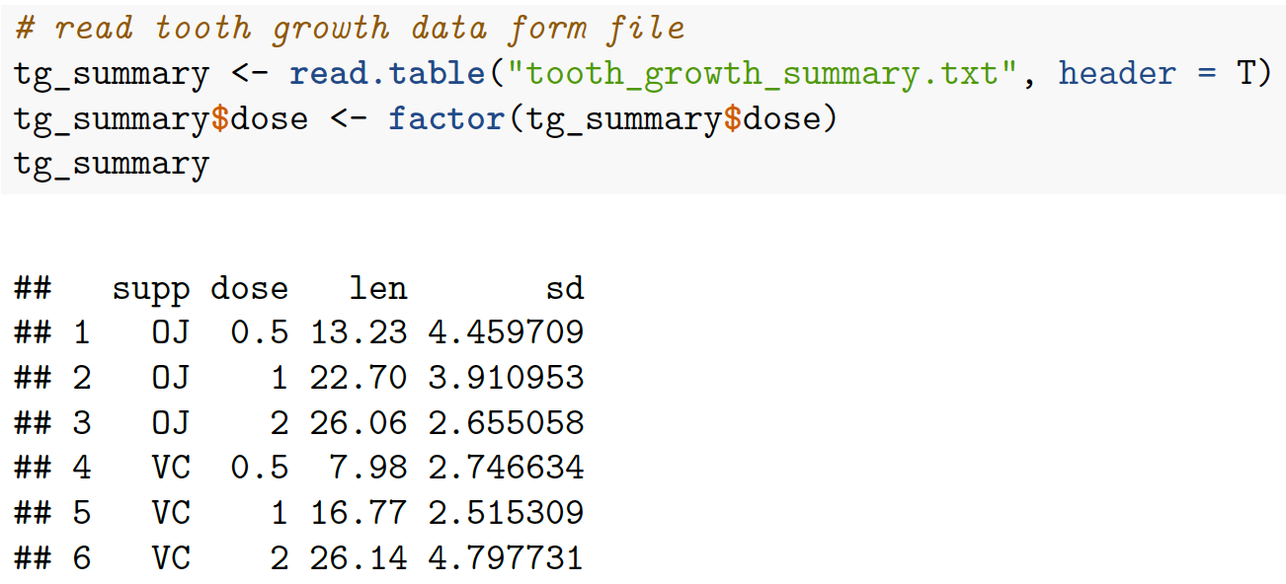
Bar Plot

Slide 77
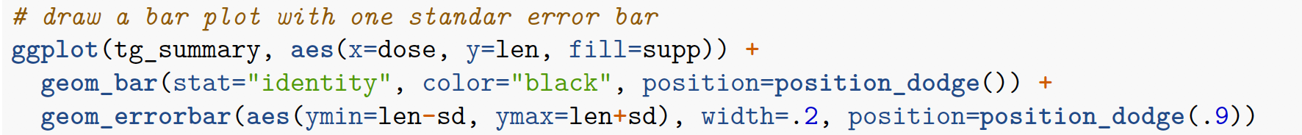
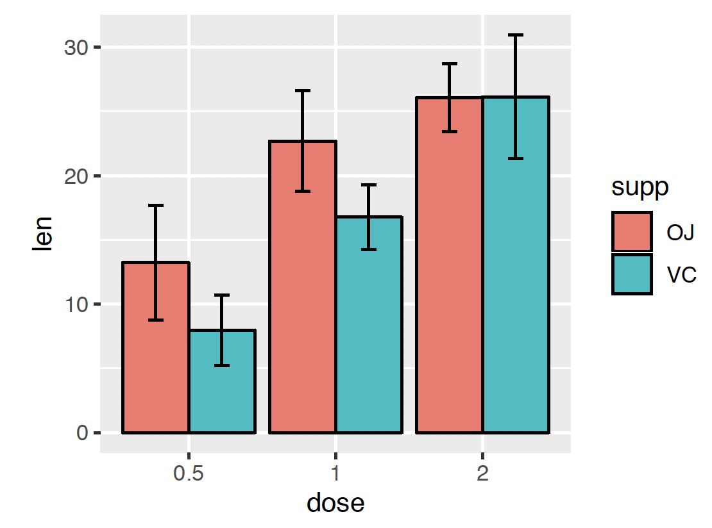
Bar Plot

Slide 78
Exercise 2.3

Slide 79
Change Shape of Points

Slide 80
Change Size of Points

Slide 81
Change Axis Labels

Slide 82

Customize Themes
Notes:
Especially font sizes of axes

Slide 83
Exercise 2.4

Slide 84


Layers – Example with Regression Line
Notes:
Regression line and points

Slide 85


Color Platte
Notes:
Color-blind friendly platte

Slide 86

Facets

Slide 87

Save Plot in a Variable

Slide 88
Save a Plot
ggsave("myggplot.pdf”)
p+ggsave("myggplot.pdf”)
ggsave("myggplot.pdf", width = 888, height = 725)
ggsave("myggplot.png”)
ggsave("myggplot.tiff”)

Slide 89
What about Annotation on the Plot?
Annotation of regression line?
Don’t forget about other convenient tools!
Notes:
Annotation of Regression Line
Painting tools in your laptop

Slide 90


What about Annotation on the Plot?
Annotation of regression line?
Don’t forget about other convenient tools!
Notes:
Annotation of Regression Line
Painting tools in your laptop

Slide 91
Helpful Materials
Statistical Analysis in R
An Introduction to Statistical Learning: With Applications in R
Applied linear statistical models
Visualization in R
R cheat sheet
Google ggplot2 reference to to go the following website, https://ggplot2.tidyverse.org/reference/index.html
Stack Overflow with keywords, “R” or “ggplot2”
R for Data Science available at https://r4ds.had.co.nz/
The R Graphics Cookbook by Winston Chang

